Slide 1


Jurgis Stepenka
April 15, 2024

Slide 2

What is MySampleSize?
Statistical calculation website, helps researchers design experiments such that they are statistically reproducible.
Includes tools such as a power plot generator, a sample size calculator, random number generator etc.
Step by step experiment design guide

Slide 3
Goals
The aim of the project is to provide an easily accessible, and usable way for researchers to design properly reproducible experiments
To minimize workload of researchers by handling the statistical math so they can focus on their field of research
To reduce the amount of money wasted on experiments that are not correctly designed

Slide 4

Justification
Minor in stats, which works well with a website that focuses on statistical calculations
Gives me experience working with an existing project, understanding how it works, and successfully making changes

Slide 5

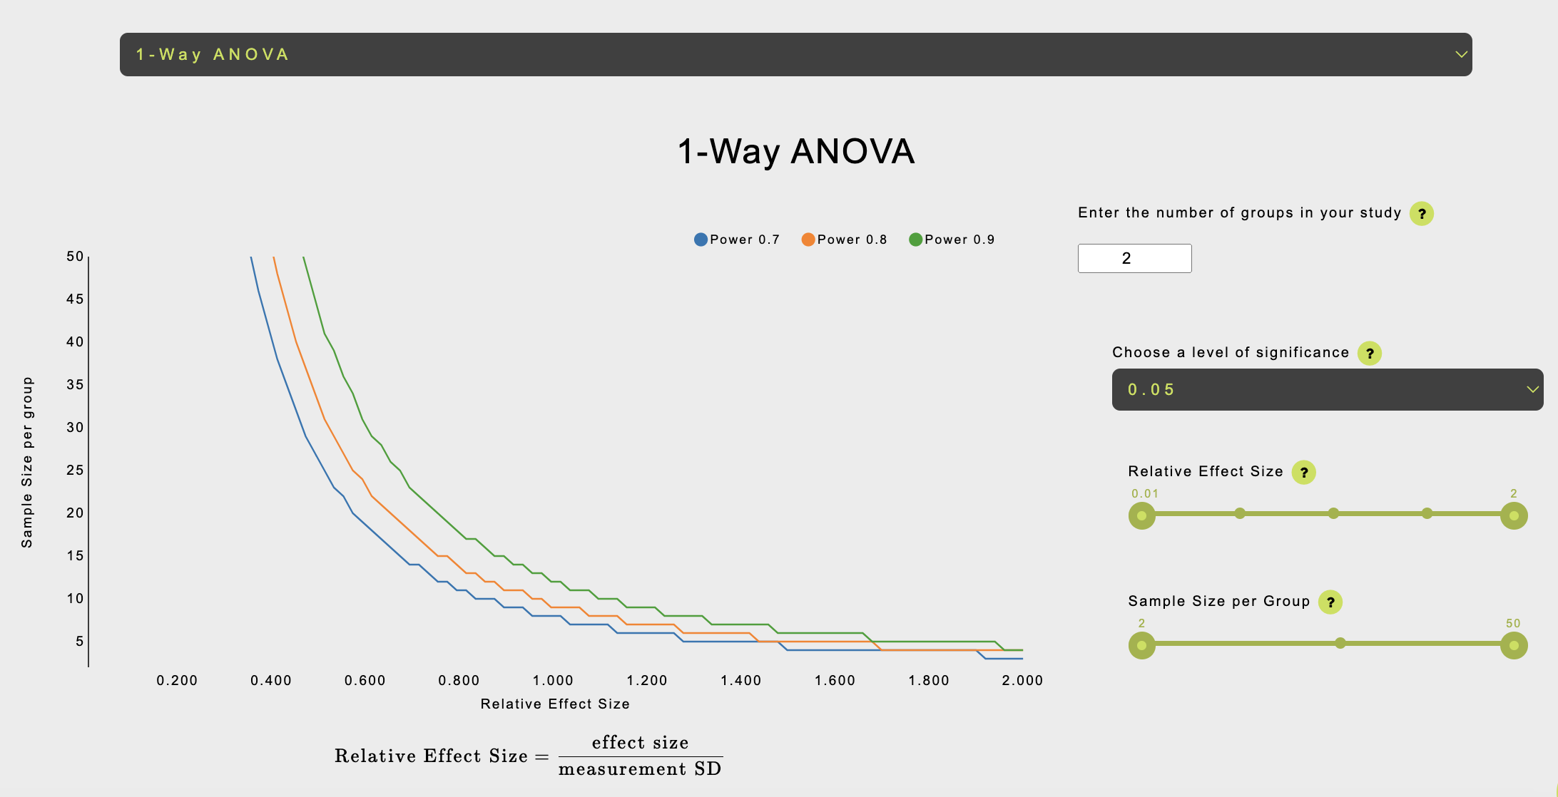

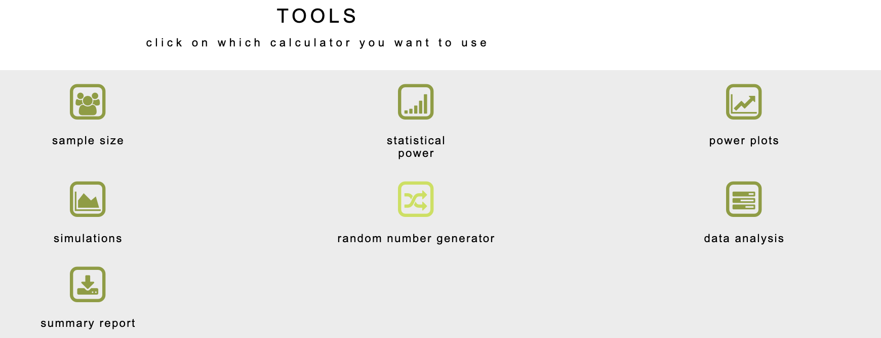
Operation

Slide 6

Demonstration

Slide 7
Challenges
Changing the package used for graphs
Rpy2 to statsmodels and matplotlib
Would not reduce the total number of decencies in the project, and would risk creating new bugs while implementing new package
PDF package change
Weasyprint relies on external library GTK
Xhtml2pdf does not work with all css styles, causing problems in the generation of PDF with new package

Slide 8


Status Update
Update to Python 3.10+
As of right now, project runs at 3.9 updated from 3.6 in January
3.10 might be possible once Weasyprint is fully removed
Rpy2 Removal
Process started, but decided it was best to leave rpy2 as the package for generated graphs, as implementing the alternatives would most likely cause issues
Total number of packages would remain the same
Weasyprint Removal
New package has been put into the project – xhtml2pdf which also converts HTML into a PDF
Weasyprint has been replaced, but not yet removed

Slide 9
Thanks / Questions

